Slide 1

Trinity Baptist Church, Columbus OHIO
Spring ‘26
Bible Study Intensive
Serving With Your Strength
Ensuring that we are serving in ministry for the right reason, with the right attitude and with necessary skills needed to do a good work that gives glory to God and edifies the believers.

Slide 2
INTENSIVE LESSON PLAN
Lesson I
Introduction and Foundation
Lesson II
Strength Discovery
Lesson III
Strength Application

Slide 3
Trinity Baptist Church is empowered by the Holy Spirit to Compel the World to Salvation and Discipleship
through Jesus Christ

Slide 4
1 Peter 4:10-11
10 Each of you should use whatever gift you have received to serve others, as faithful stewards of God’s grace in its various forms. 11 If anyone speaks, they should do so as one who speaks the very words of God. If anyone serves, they should do so with the strength God provides, so that in all things God may be praised through Jesus Christ. To him be the glory and the power for ever and ever. Amen.

Slide 5
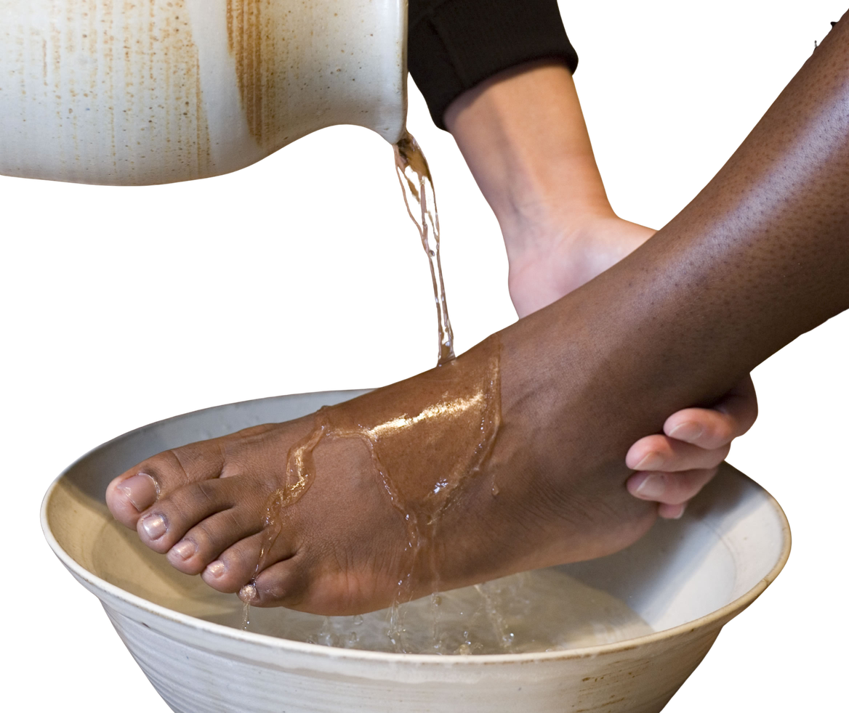
SERVING
Is an expression of God’s love, exemplified by Jesus’ humility and self-sacrifice. It is meeting the needs of others motivated by the Holy Spirit’s presence in one’s life.

Slide 6
  Philippians 2:3-4 (NIV): "Do nothing out of selfish ambition or vain conceit. Rather, in humility value others above yourselves..."
  Mark 9:35 (NIV): "Sitting down, Jesus called the Twelve and said, 'Anyone who wants to be first must be the very last, and the servant of all.'"
  John 13:14 (NIV): "Now that I, your Lord and Teacher, have washed your feet, you also should wash one another’s feet."

Slide 7

STRENGTH
spiritual and divine empowerment that comes from God, rather than mere physical ability. It involves inner resilience, steadfastness, and confidence in God's power—especially during human weakness, where Christ’s strength is made perfect.

Slide 8
  Empowerment through Christ
Philippians 4:13: "I can do all things through him who strengthens me."
  Strength in vulnerability
2 Corinthians 12:9: "My grace is sufficient for you, for my power is made perfect in weakness."
  Strength through waiting on God
Isaiah 40:31: "But those who hope in the Lord will renew their strength..."
  Source of strength
Ephesians 6:10: "...be strong in the Lord and in his mighty power."
  Emotional/spiritual fortitude
Nehemiah 8:10: "...do not sorrow, for the joy of the Lord is your strength."

Slide 9
Biblical Characters
  Peter, Andrew, James, & John: Disciples who were Fishermen based in Capernaum, often mending nets.
  Matthew (Levi): a disciple who was A tax collector for the Roman government, likely educated.
  Judas Iscariot: a disciple who was the Treasurer for the group, holding a role involving money management.
  Simon the Zealot: a disciple who was Part of a political, anti-Roman movement rather than a conventional job.
  Paul: A tentmaker by trade
  Luke: Physician
  Rahab: Business Woman
  Priscilla and Aquila: Business Persons
  Ananias and Sapphira: Real Estate
  Ruth: A farm worker
  Deborah: Judge and Prophet

Slide 10
Faith vs. Faithfulness

Slide 11
Faith (Belief): trust or reliance in Christ for salvation. It is the inward conviction.
Faithfulness (Action): trustworthy, loyal, consistent, and dependable, reliable, commitment to duty and adherence to, or reliance on.

Slide 12

Does Faithfulness mean that one has the ability (the strength) to fulfill the assignment?

Slide 13
1 Corinthians 12:4-11
4 There are different kinds of gifts, but the same Spirit distributes them. 5 There are different kinds of service, but the same Lord. 6 There are different kinds of working, but in all of them and in everyone it is the same God at work. 7 Now to each one the manifestation of the Spirit is given for the common good. 8 To one there is given through the Spirit a message of wisdom, to another a message of knowledge by means of the same Spirit, 9 to another faith by the same Spirit, to another gifts of healing by that one Spirit, 10 to another miraculous powers, to another prophecy, to another distinguishing between spirits, to another speaking in different kinds of tongues, and to still another the interpretation of tongues.11 All these are the work of one and the same Spirit, and he distributes them to each one, just as he determines.

Slide 14

What Strengths to do I Possess for the Good of the Church?

Slide 15

Galatians 5:22-23

Slide 16
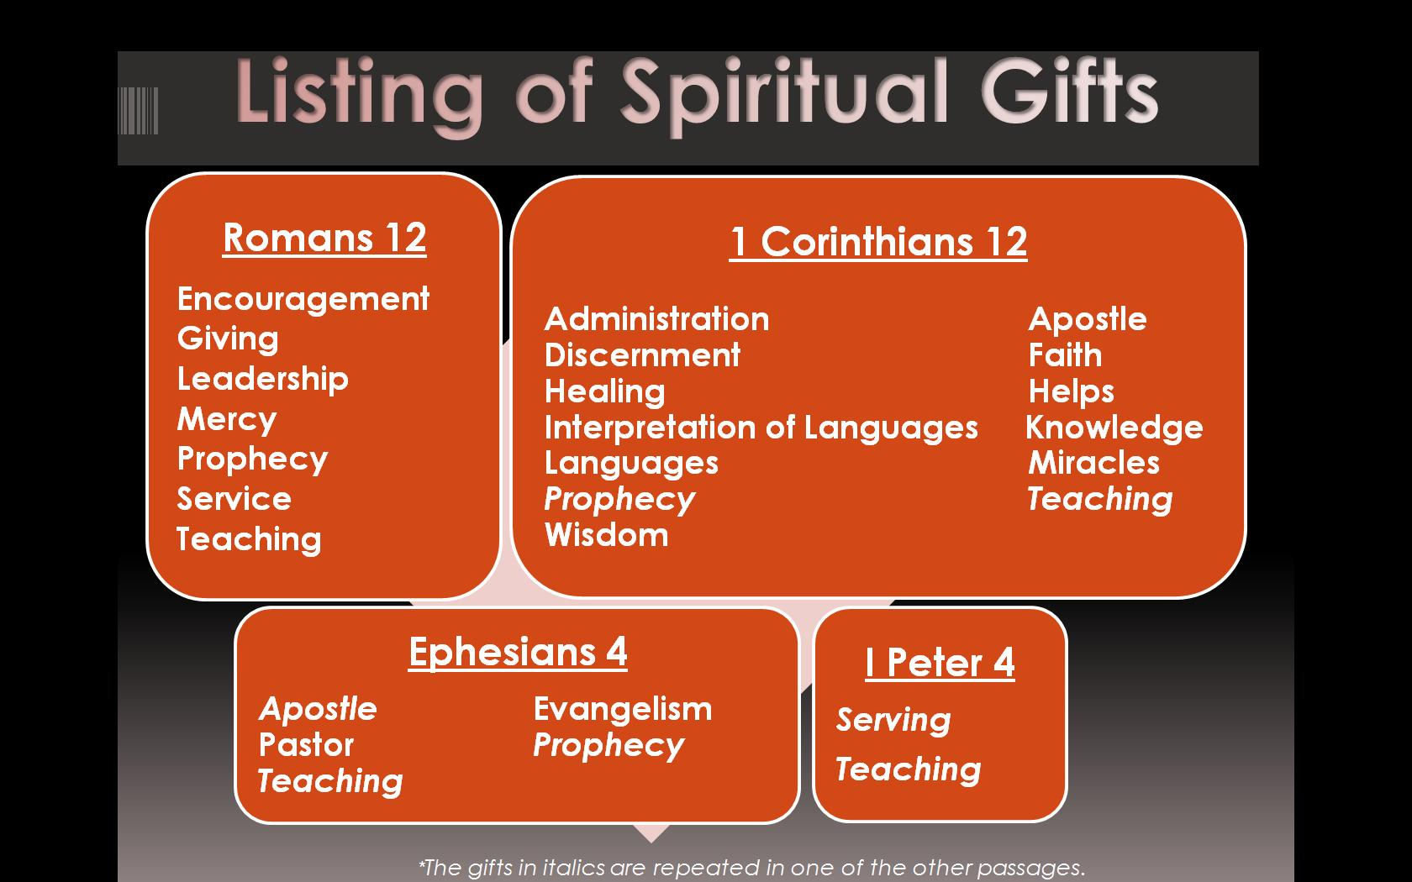

Slide 17
When your strength is enhanced by Spiritual gifting there is divine impact.

